Slide 1
Physics-Informed Neural Networks (PINNs)

Slide 2
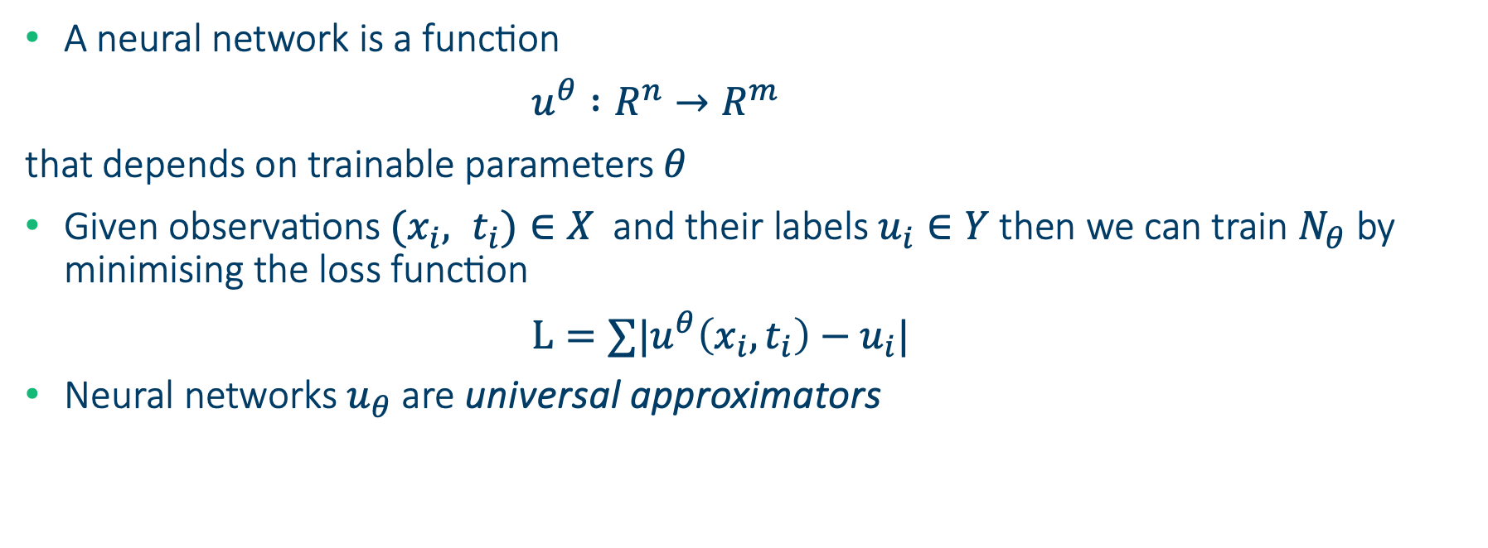
Neural networks recap
A neural network is a function
$u^{θ} :R^{n}→R^{m}$
that depends on trainable parameters $θ$
Given observations ${(x}_{i}, t_{i})∈X$ and their labels $u_{i}∈Y$then we can train $N_{θ}$ by minimising the loss function
$L=∑|u^{θ}\left(x_{i}, t_{i}\right)−u_{i}|$
Neural networks $u_{θ}$ are universal approximators

Slide 3
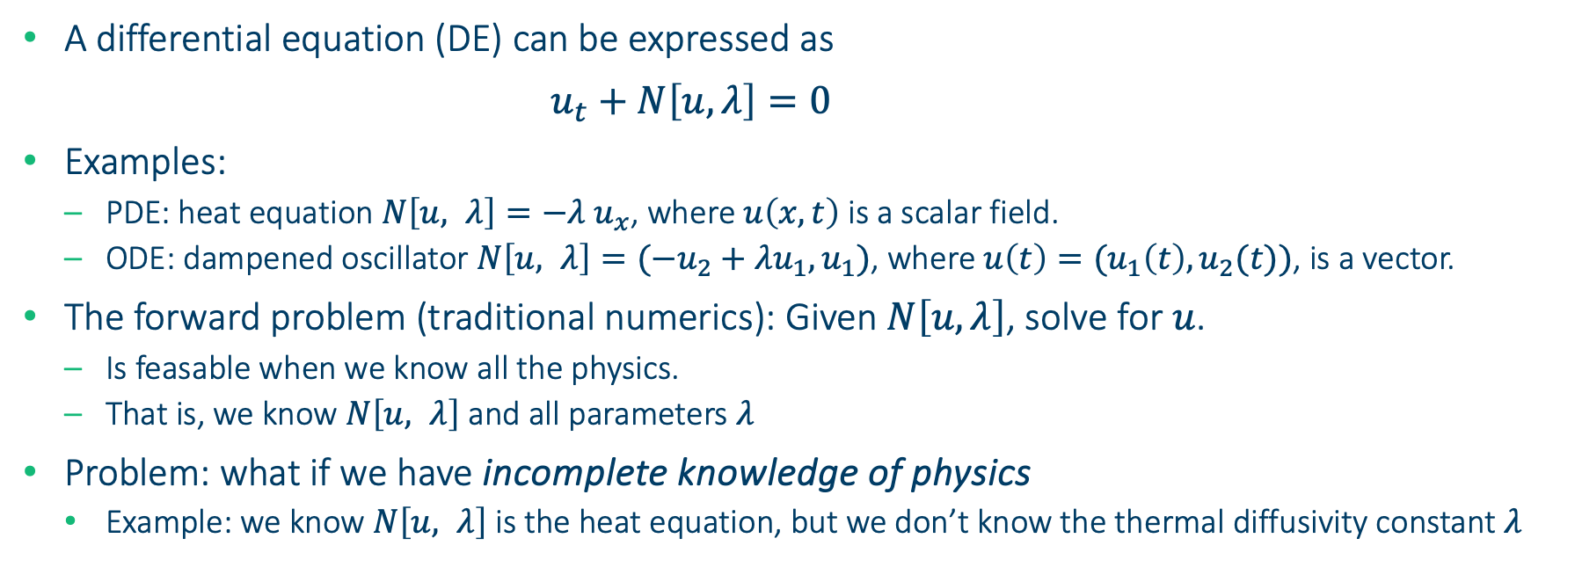
Solving differential equations
A differential equation (DE) can be expressed as
$u_{t}+N\left[u, λ\right]=0$
Examples:
PDE: heat equation $N\left[u, λ\right]=−{λ u}_{x}$, where $u\left(x, t\right)$ is a scalar field.
ODE: dampened oscillator $N\left[u, λ\right]=(−u_{2}+λu_{1}, u_{1})$, where $u\left(t\right)=(u_{1}\left(t\right),u_{2}(t))$, is a vector.
The forward problem (traditional numerics): Given $N\left[u, λ\right]$, solve for $u$.
Is feasable when we know all the physics.
That is, we know $N\left[u, λ\right]$ and all parameters $λ$
Problem: what if we have incomplete knowledge of physics
Example: we know $N\left[u, λ\right]$ is the heat equation, but we don’t know the thermal diffusivity constant $λ$

Slide 4
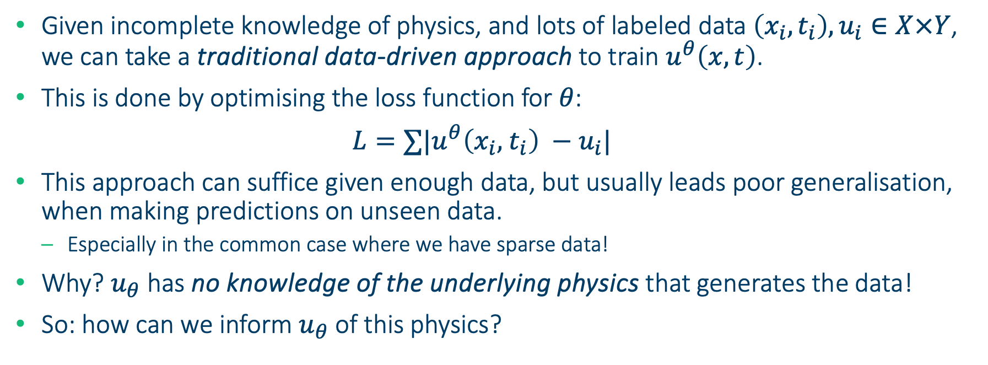
Potential solution: lots of data
Given incomplete knowledge of physics, and lots of labeled data $\left(x_{i},t_{i}\right), u_{i}∈X×Y$, we can take a traditional data-driven approach to train $u^{θ}\left(x, t\right)$.
This is done by optimising the loss function for $θ$:
$L=∑|u^{θ}\left(x_{i}, { t}_{i}\right) −u_{i}|$
This approach can suffice given enough data, but usually leads poor generalisation, when making predictions on unseen data.
Especially in the common case where we have sparse data!
Why? $u_{θ}$ has no knowledge of the underlying physics that generates the data!
So: how can we inform $u_{θ}$ of this physics?

Slide 5
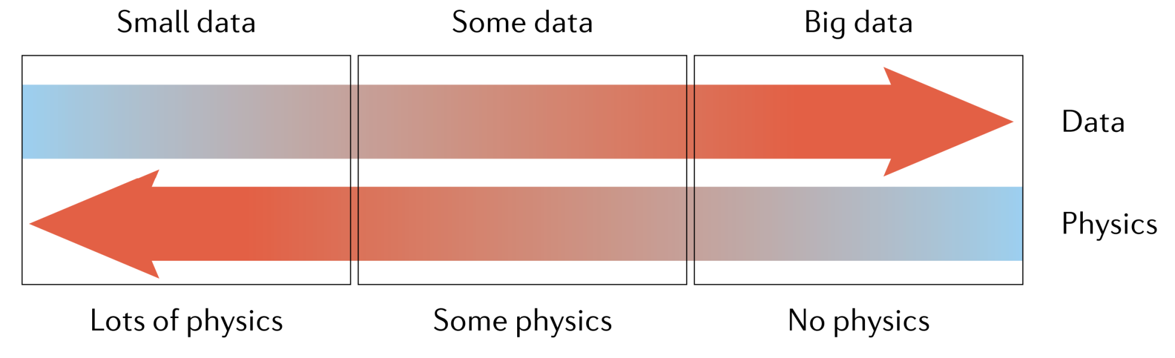
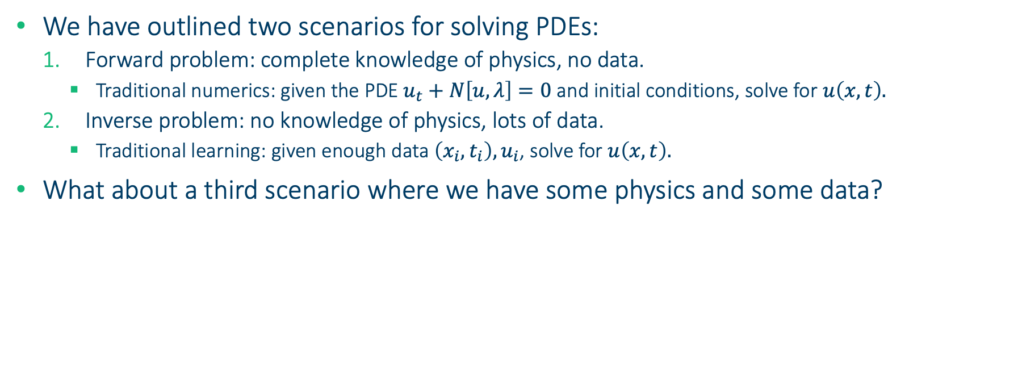
Some physics and some data
We have outlined two scenarios for solving PDEs:
Forward problem: complete knowledge of physics, no data.
Traditional numerics: given the PDE $u_{t}+N\left[u, λ\right]=0$ and initial conditions, solve for $u\left(x, t\right).$
Inverse problem: no knowledge of physics, lots of data.
Traditional learning: given enough data $\left(x_{i},t_{i}\right), u_{i}$, solve for $u\left(x, t\right).$
What about a third scenario where we have some physics and some data?
Scenario 1
???
Scenario 2

Slide 6
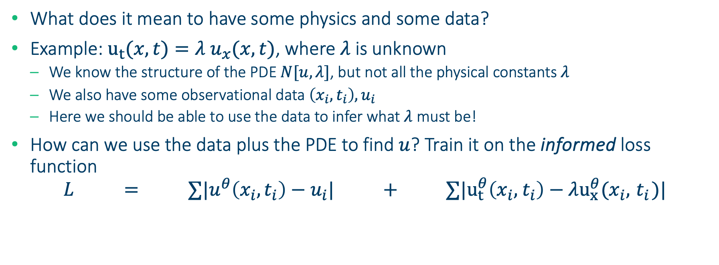
Physics informed neural networks (PINNs)
What does it mean to have some physics and some data?
Example: $u_{t}(x, t)={λ u}_{x}(x, t)$, where $λ$ is unknown
We know the structure of the PDE $N[u, λ]$, but not all the physical constants $λ$
We also have some observational data $\left(x_{i},t_{i}\right), u_{i}$
Here we should be able to use the data to infer what $λ$ must be!
How can we use the data plus the PDE to find $u$? Train it on the informed loss function
$${L = ∑|u}^{θ}\left(x_{i}, t_{i}\right)−u_{i}| + ∑|u_{t}^{θ}\left(x_{i}, { t}_{i}\right)−λu_{x}^{θ}(x_{i}, { t}_{i})|$$
PINN Loss
=
Traditional, data-driven loss
+
Additional PDE loss

Slide 7
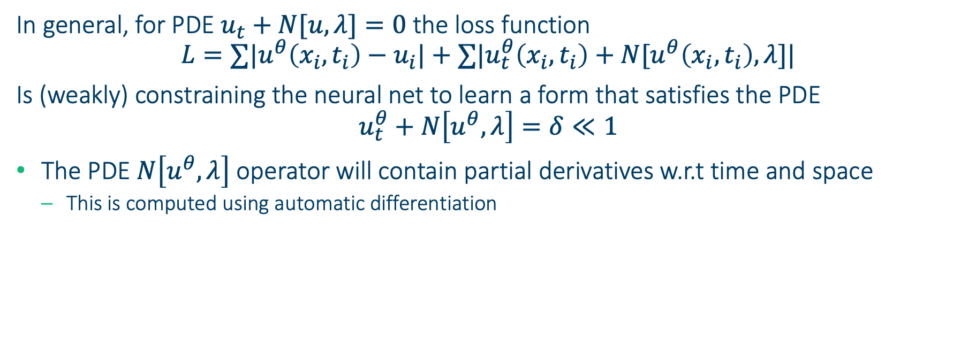
Physics informed neural networks (PINNs)
In general, for PDE $u_{t}+N[u, λ]=0$the loss function
$${L=∑|u}^{θ}\left(x_{i}, t_{i}\right)−u_{i}|+∑|u_{t}^{θ}\left(x_{i}, t_{i}\right)+N[u^{θ}\left(x_{i}, t_{i}\right), λ]|$$
Is (weakly) constraining the neural net to learn a form that satisfies the PDE
$$u_{t}^{θ}+N\left[u^{θ}, λ\right]=δ≪1$$
The PDE $N\left[u^{θ}, λ\right]$ operator will contain partial derivatives w.r.t time and space
This is computed using automatic differentiation

Slide 8
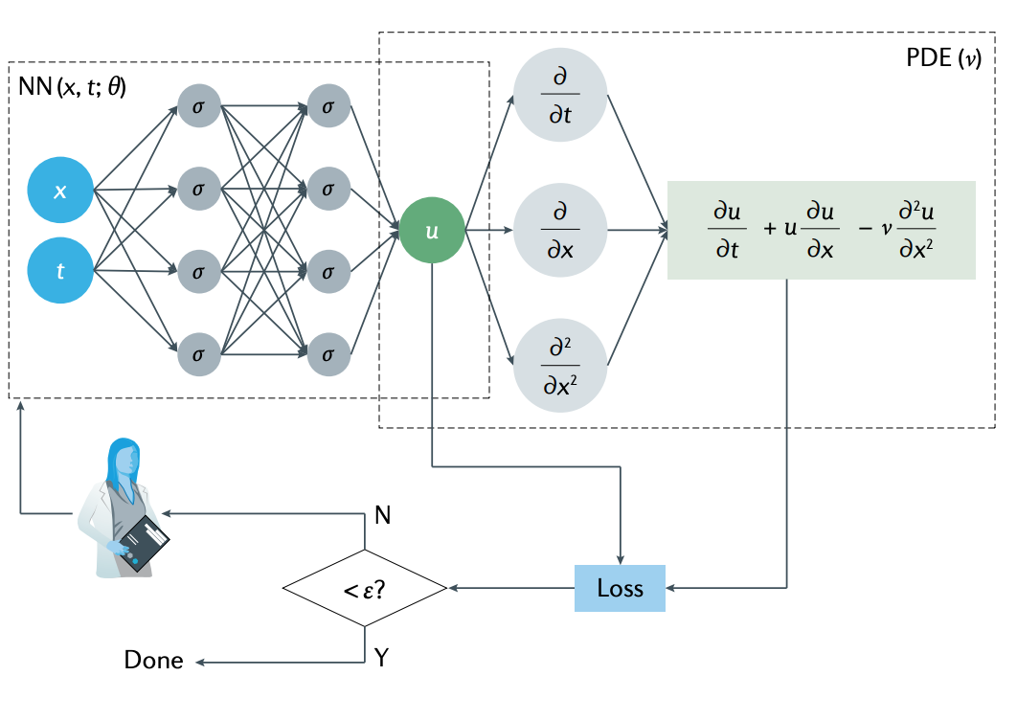
Physics informed neural networks (PINNs)

Slide 9
Advantages of PINNs
Data Efficiency: Less data might be needed if physical laws are known
Interpretable Models: Discuss how the models can be more understandable
Predictive Accuracy: Mention how accuracy can be improved for certain problems

Slide 10
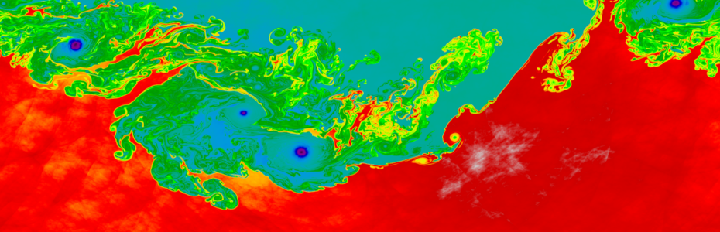
Potential uses of PINN
Where do traditional numerics beat PINNs?
Most forward problems
Shocks
Turbulence
Where are PINNs somewhat promising?
Inverse problems
Data-assimilation problems(?)
Difficult geometries where meshing is not feasible
Reduced order models

Slide 11
Applications
Examples in Engineering, Climate Science, etc.: Provide a couple of concrete examples
Case Study: A quick walk-through of a real-world problem solved using PINNs

Slide 12
Challenges and limitations
Computational Complexity: Discuss the computational cost
Requirement for Physical Laws: The need for accurate equations
“Weakly” enforces physical constraints.

Slide 13
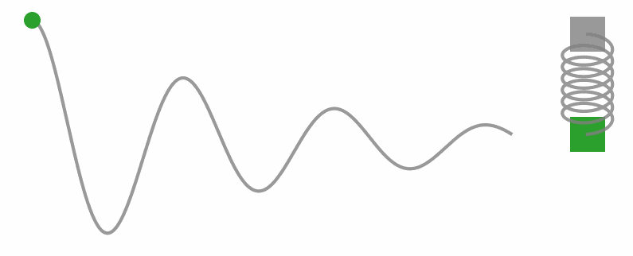
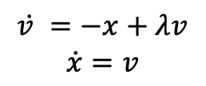
Coding exercise
$$\dot{v }=−x+λv$$
$$\dot{x}=v$$
Simulate the dynamics of an oscillating spring with resistance.
We will first use a data-driven, physics agnostic approach
Then we will “inform” the loss function about the physics

